Slide 1
JAVASCRIPT

Slide 2
Introduction to Scripting- Programming fundamentals of JavaScript -Obtaining User Input with prompt Dialogs-Arithmetic-Decision Making -Control Statements - Functions -Arrays -Objects -Document Object Model (DOM) -Form processing

Slide 3
JavaScript is a scripting language, which is used to enhance the functionality and appearance of web pages
JavaScript is a Client side scripting tool
JavaScript is used in Web pages to improve the design, validate forms, detect browsers, create cookies, and much more.
JavaScript is the most popular scripting language on the internet, and works in all major browsers, such as Internet Explorer, Mozilla, Firefox, Netscape, Opera
JavaScript and Java are only related through syntax →JavaScript is dynamically typed →JavaScript’s support for objects is very different

Slide 4
Java and JavaScript are two completely different languages in both concept and design!
Java (developed by Sun Microsystems) is a powerful and much more complex programming language - in the same category as C and C++.
Object model of javascript is quite different from java & C++
Java is strongly typed and Javascript is Dynamically typed
In Java ,types are all known at compile time, where as compile time type checking impossible
Objects in Java are static (variables or function is shared between all instances of class)where as objects are dynamic

Slide 5
JavaScript was designed to add interactivity to HTML
JavaScript is a scripting language
It is usually embedded directly into HTML pages
JavaScript is an interpreted language provide programming capability at both the server and the client ends of a Web connection.
Improve appearance especially graphics
Site navigation
Perform calculations
Validation of input
DOM allows Javascript to access &modify the style

Slide 6
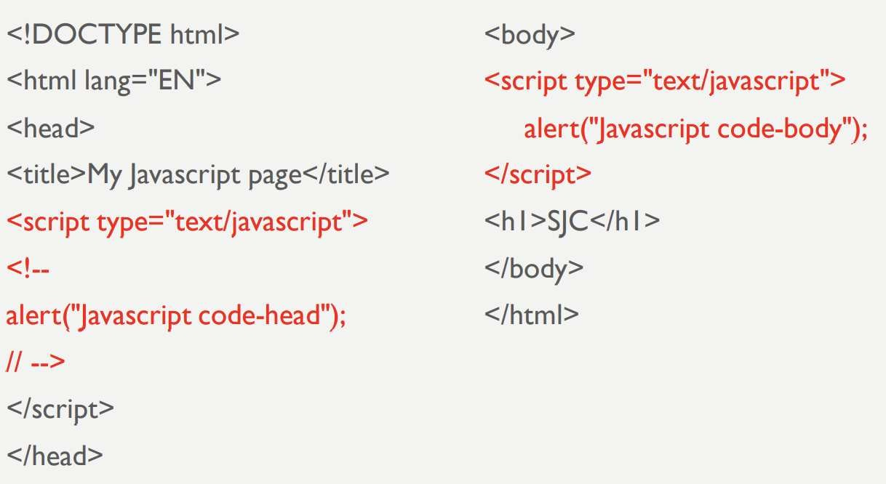
How to put JAVASCRIPT in HTML code?

Slide 7
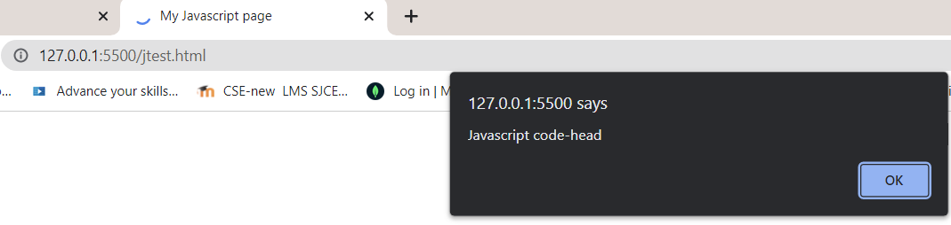

Slide 8
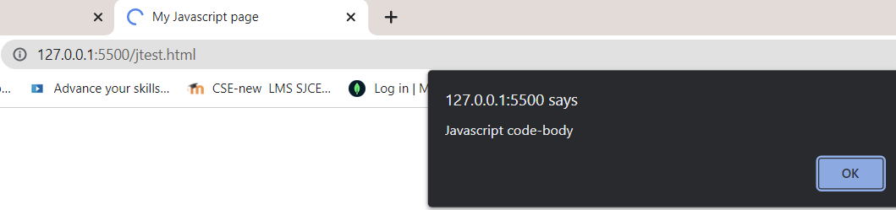
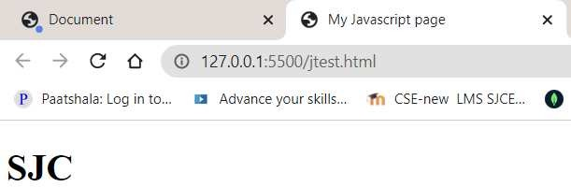

Slide 9
How to embed JavaScript in an HTML document
When a JavaScript script is encountered in the HTML document, the browser uses its JavaScript interpreter to “execute” the script.
Output from the script becomes the next markup to be rendered.
When the end of the script is reached, the browser goes back to reading the HTML document and displaying its content.
There are two different ways to embed JavaScript in an HTML document:
– implicitly and explicitly.

Slide 10
In explicit embedding, the JavaScript code physically resides in the XHTML document.
In implicit embedding the JavaScript can be placed in its own file(.js file), separate from the XHTML document.
When JavaScript scripts are explicitly embedded, they can appear in either part of an XHTML document—the head or the body

Slide 11
The interpreter notes the existence of scripts that appear in the head of a document, but it does not interpret them while processing the head.
Scripts that are found in the body of a document are interpreted as they are found.

Slide 12
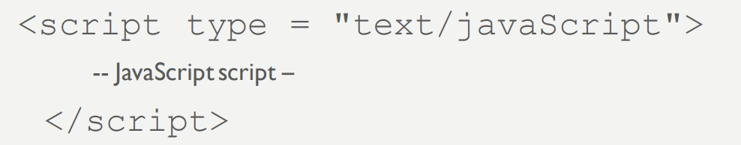
JavaScript are embedded in HTML documents , Either directly, as in • -

Slide 13
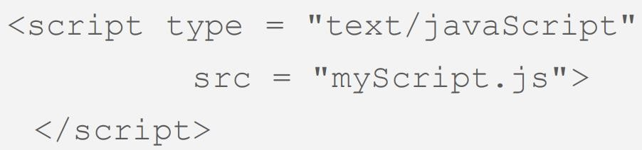

Slide 14
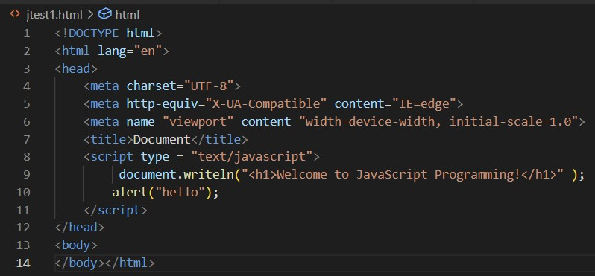
JavaScript “hello” example in an HTML document

Slide 15
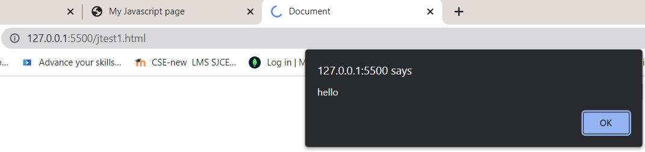

Slide 16
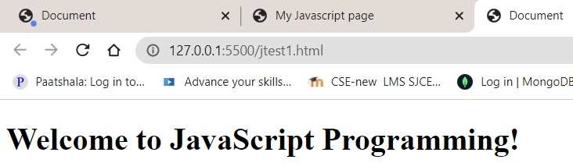

Slide 17
How to embed JavaScript in an HTML document
<script> tag to indicate to the browser that the text which follows is part of a script.
The type attribute specifies the MIME type of the script as well as the scripting language used in the script—in this case, a text file written in javascript.
In HTML5, the default MIME type for a <script> is "text/html", so you can omit the type attribute from your <script> tags
Individual white-space characters between words in a string are not ignored by the browser.
browsers ignore leading white-space characters (i.e., white space at the beginning of a string).
Strings in JavaScript can be enclosed in either double quotation marks (") or single quotation marks
(‘)

Slide 18
document object, which represents the HTML5 document the browser is currently displaying.
This object allows you to specify text to display in the HTML5 document.
document object’s writeln method is used to write a line of HTML5 markup in the HTML5 document.
Method writeln instructs the browser to write the argument string into the web page for rendering.
If the string contains HTML5 elements, the browser interprets these elements and renders them on the screen.

Slide 19
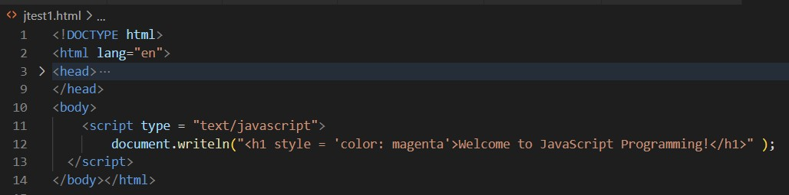
JavaScript “hello” example with inline style

Slide 20
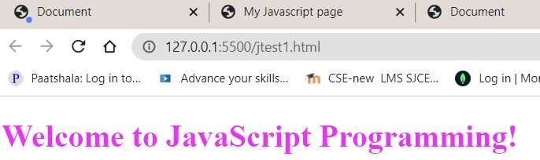

Slide 21
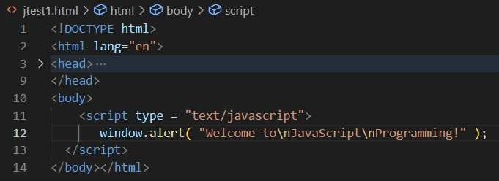
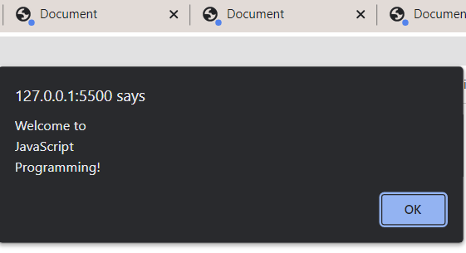
JavaScript example with alert

Slide 22
JavaScript example with alert-Usage of Escape Sequence
the backslash (\) in a string is an escape character.
It indicates that a “special” character is to be used in the string.
When a backslash is encountered in a string, the next character is combined with the backslash to form an escape sequence.

Slide 23
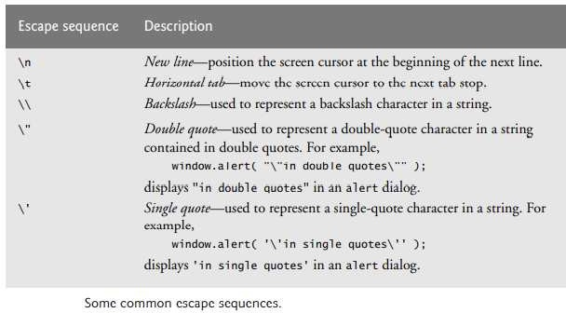

Slide 24
Programming fundamentals of JavaScript
Identifier form: begin with a letter or underscore, followed by any number of letters, underscores, and digits
Case sensitive
25 reserved words, plus future reserved words
Comments: both // and /* … */
Scripts are usually hidden from browsers that do not include JavaScript interpreters by putting them in special comments
<!--
-- JavaScript script –
//-->

Slide 25
Semicolons can be a problem. They are “somewhat” optional.
Problem : When the end of the line can be the end of a statement ,JavaScript puts a semicolon there
When separated by semicolons, multiple statements on one line are allowed: a = 5; b = 6; c = a + b;

Slide 26
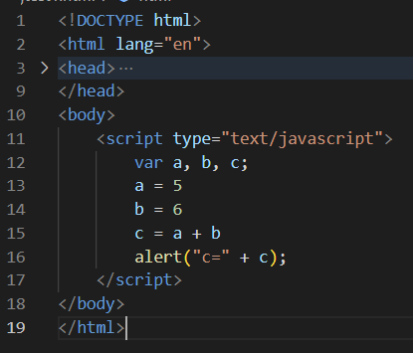
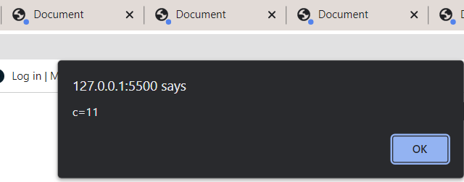

Slide 27
PRIMITIVES
JavaScript provides different data types to hold different types of values.
1.Primitive Types
five primitive types:
Number,
String
Boolean,
Undefined,
Null
2.Non-Primitive Types
Objects such as functions and arrays are referred to as non-primitive values.

Slide 28
Primitive Types
five primitive types: Number, String, Boolean, Undefined, or Null
Number, String, and Boolean have wrapper objects (Number, String, and Boolean).
Wrapper objects are used to provide properties and methods that are convenient to use with the values of primitive types.
Anything that doesn’t belong to any of these five primitive types is considered an object.

Slide 29
BUT each of these five primitive data types has a corresponding object constructor..
First as a primitive data type:
var word = "hello";
And then as an object:
var word = new String("hello");

Slide 30
The fundamental difference between primitives and non-primitives is that primitives are immutable and non-primitives are mutable.
Primitives are known as being immutable data types because there is no way to change a primitive value once it gets created.
var s = 'This is a string.’; s[1] = ‘H’;
alert(s) // 'This is a string.’

Slide 31
Non-primitive values are mutable data types.
The value of an object can be changed after it gets created.
var arr = [ 'one', 'two', 'three', 'four', 'five’ ];
arr[1] = 'TWO’;
alert(arr) // [ 'one', 'TWO', 'three', 'four', 'five' ];

Slide 32
Numeric & String Literals,Other Primitives
Numeric literals – like Java All numeric values are stored in double-precision floating point
72,7.2,.72,7E2,7e2 etc are valid
String literals are delimited by either ' or "
Can include escape sequences (e.g., \t)
All String literals are primitive values
Other Primitive Types

Slide 33
Boolean values are true and false.
Used for evaluating Boolean Expressions
The only Null value is null-means no value variable has not been explicitly declared or assigned a value.
The only Undefined value is undefined-variable has been explicitly declared, but not assigned a value
A variable declared without a value will have the value undefined. ex)var carName;

Slide 34
Declaring variables
JavaScript is dynamically typed – any variable can be used for anything
The interpreter determines the type of a particular occurrence of a variable
Keywords are words that have special meaning in JavaScript.
The keyword var at the beginning of the statement indicates that the word name is a variable.

Slide 35
A variable is a location in the computer’s memory where a value can be stored for use by a script.
All variables have a name and value, and should be declared with a var statement before they’re used in a script.
Variables can be implicitly or explicitly declared
var sum =0,today ="Monday", flag = false; var counter;
Variable names are case sensitive , They must begin with a letter or the underscore character

Slide 36
The name of a variable can be any valid identifier.
An identifier is a series of characters consisting of letters, digits, underscores ( _ ) and dollar signs ($) that does not begin with a digit and is not a reserved JavaScript keyword.
Identifiers may not contain spaces.
Some valid identifiers are Welcome, $value, _value, m_inputField1 and button7.

Slide 37
The name 7button is not a valid identifier, because it begins with a digit, and the name ‘input field’ is not valid, because it contains a space.
Remember that JavaScript is case sensitive—uppercase and lowercase letters are considered to be different characters, so name, Name and NAME are different identifiers.

Slide 38
Obtaining User Input with prompt Dialogs
Scripting gives you the ability to generate part or all of a web page’s content at the time it’s shown to the user.
A script can adapt the content based on input from the user or other variables, such as the time of day or the type of browser used by the client.
Such web pages are said to be dynamic, as opposed to static, since their content has the ability to change.

Slide 39
The script uses another predefined dialog box from the window object—a prompt dialog— which allows the user to enter a value that the script can use
The JavaScript model for the HTML document is the Document object*

Slide 40
The model for the browser display window is the Window object
The Document object has a method, write, which dynamically creates content
The parameter is a string, often catenated from parts, some of which are variables e.g.,
document.write("Answer: " + result );
The Window object has three methods for creating dialog boxes, alert, confirm, & prompt

Slide 41
prompt("What is your name?", "");
Opens a dialog box and displays its string parameter, along with a text box and two buttons, OK and Cancel
An empty string is returned for the default input
Null will be returned if we press the cancel button

Slide 42
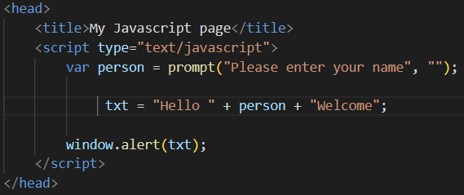

Slide 43
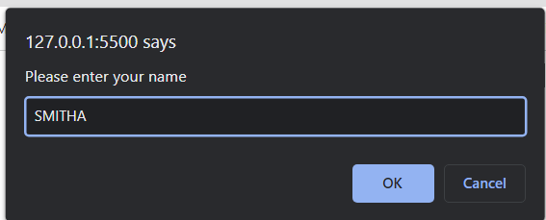

Slide 44
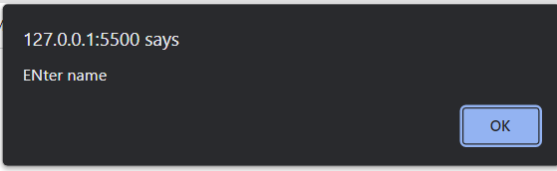
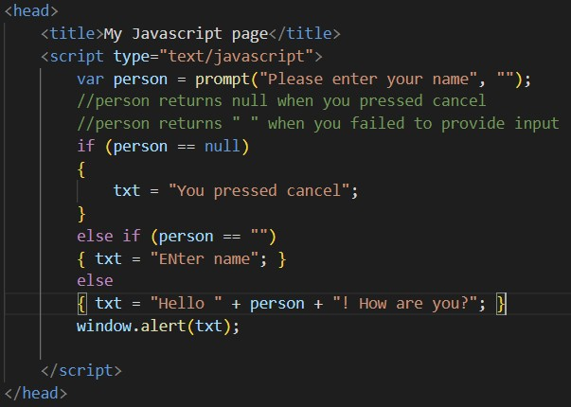
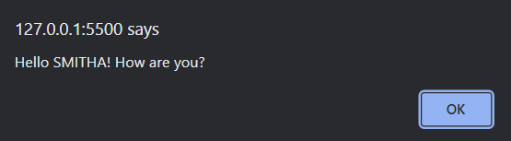

Slide 45
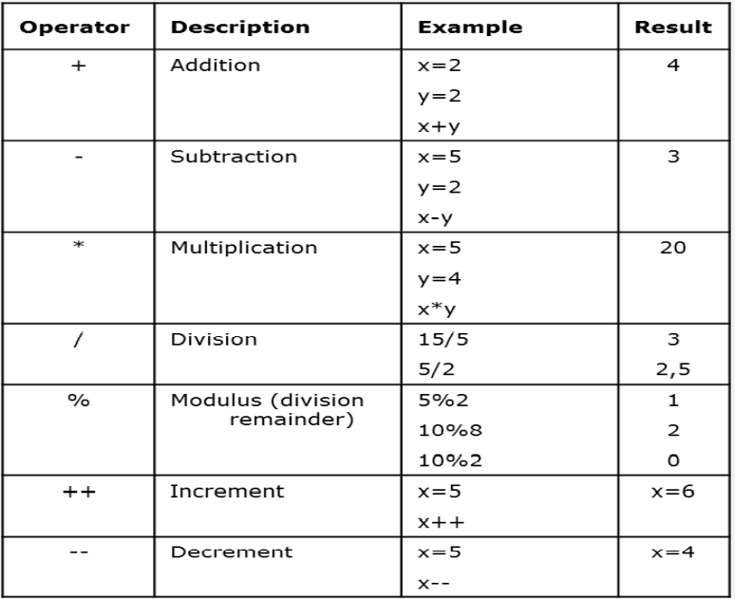
Operators
Arithmetic Operators

Slide 46
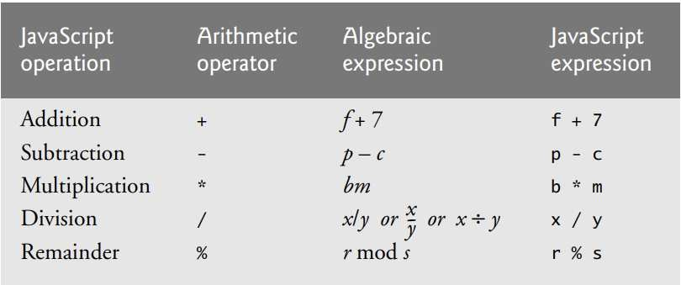
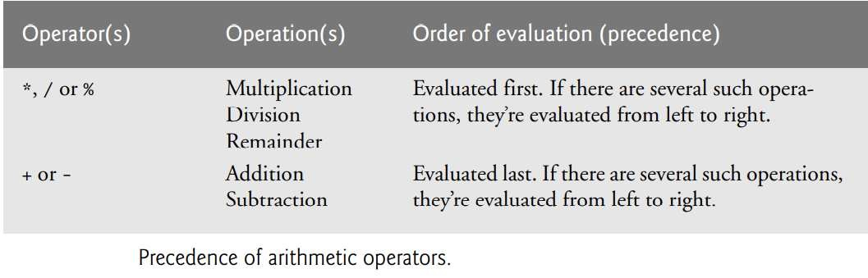

Slide 47
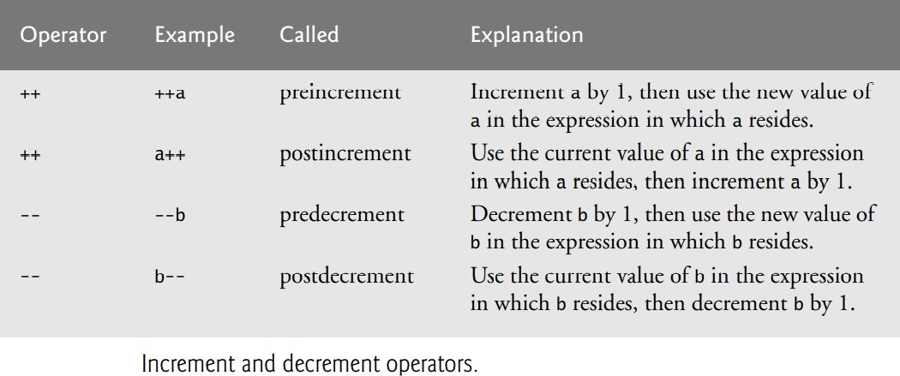

Slide 48
Operator Precedence
JavaScript applies the operators in arithmetic expressions uses the following rules of operator precedence
Multiplication, division and remainder operations are applied first. If an expression contains several multiplication, division and remainder operations, operators are applied from left to right.

Slide 49
Multiplication, division and remainder operations are said to have the same level of precedence.
Addition and subtraction operations are applied next. If an expression contains several addition and subtraction operations, operators are applied from left to right.
Addition and subtraction operations have the same level of precedence.

Slide 50
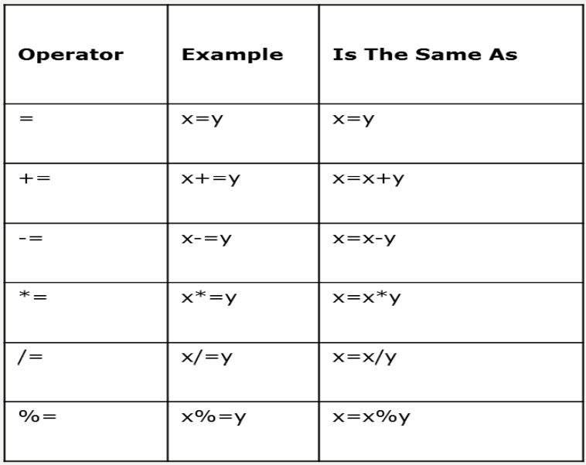

Slide 51
Assignment Operators

Slide 52
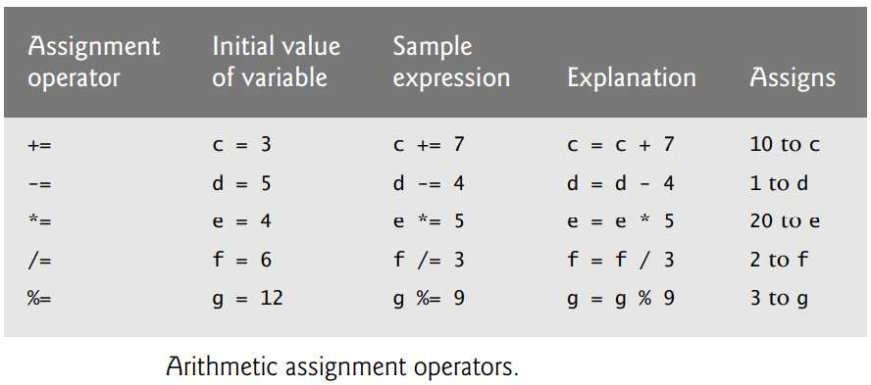
Assignment Operators

Slide 53
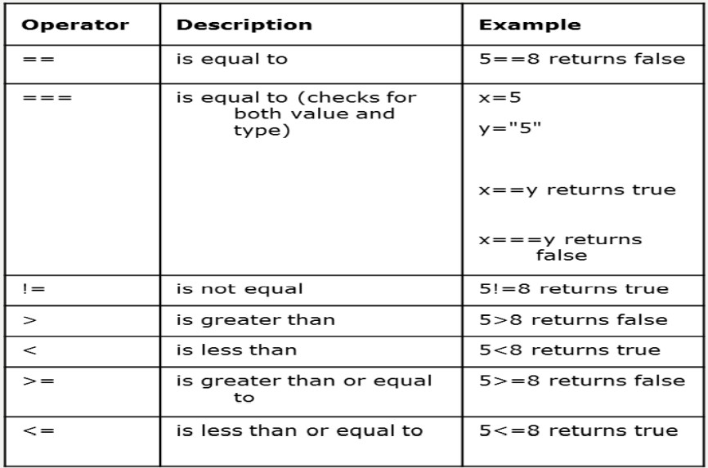
Comparison Operators

Slide 54
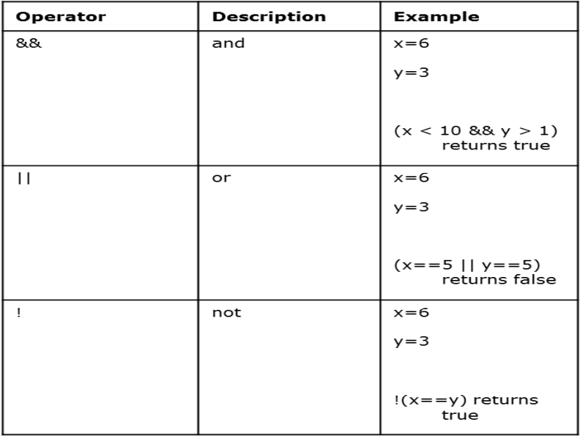
Logical Operators

Slide 55
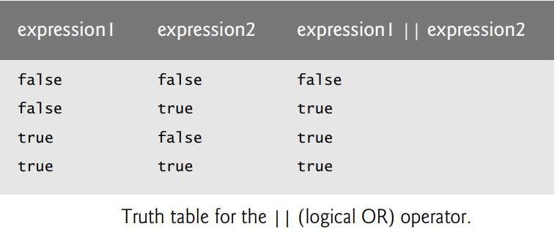

Slide 56
The && operator has a higher precedence than the || operator.
Both operators associate from left to right.
An expression containing && or || operators is evaluated only until truth or falsity is known.
the || operator immediately returns true if the first operand is true. This performance feature for evaluation of logical AND and logical OR expressions is called short-circuit evaluation

Slide 57
String Concatenation Operator
JavaScript has a version of the + operator for string concatenation that enables a string and a value of another data type (including another string) to be combined.
The result of this operation is a new (and normally longer) string
String catenation operator +

Slide 58
txt1 = “Ben";
txt2 = “Alex";
txt3 = txt1 + " " + txt2;
o/p→ Ben Alex
txt1 = "What a very ";
txt1 += "nice day"; o/p→What a very nice day

Slide 59
the + operator used for string concatenation can convert other variable types to strings if necessary.
Because string concatenation occurs between two strings, JavaScript must convert other variable types to strings before it can proceed with the operation.

Slide 60
For example, if a variable age has an integer value equal to 21, then the expression "my age is " + age evaluates to the string "my age is 21".
JavaScript converts the value of age to a string and concatenates it with the existing string literal "my age is ".

Slide 61
Creating and Using a New Date Object
Create one with the new operator & Date constructor (no params)
Local time methods of Date:

Slide 62
toLocaleString– returns a string of the date
getDate – returns the day of the month
ggetMonth – returns the month of the year (0 – 11)
etDay – returns the day of the week (0 – 6)
getFullYear– returns the year
getTime – returns the number of milliseconds since January 1, 1970
getHours – returns the hour (0 – 23)
getMinutes– returns the minutes (0 – 59)
getMilliseconds– returns the milliseconds (0 – 999)

Slide 63
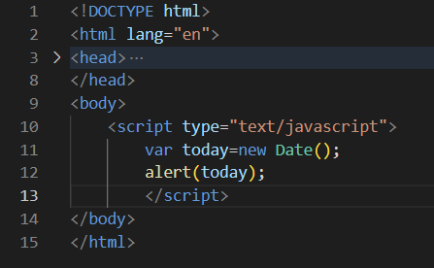
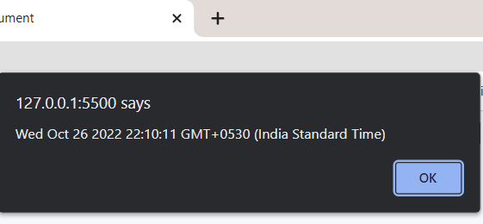

Slide 64
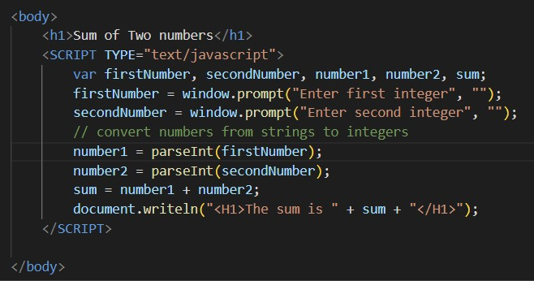
Sum of two numbers

Slide 65
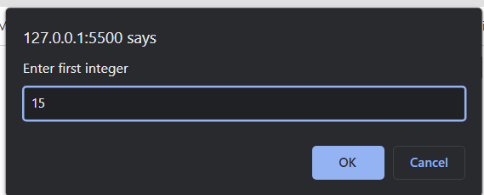
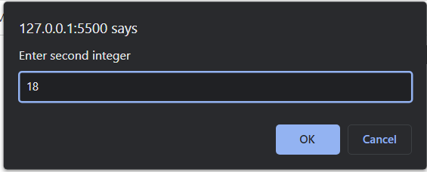

Slide 66
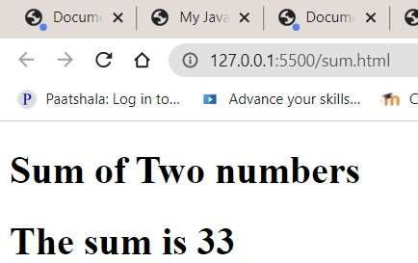

Slide 67
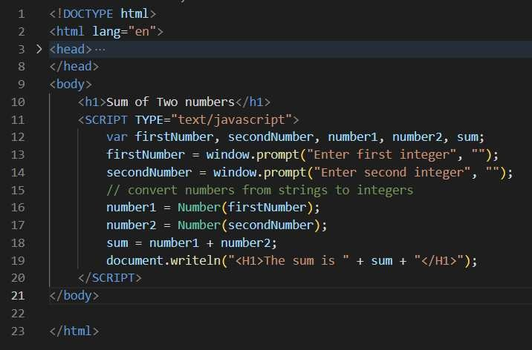

Slide 69
Memory Concepts
Variable names such as number1, number2 and sum actually correspond to locations in the computer’s memory.
Every variable has a name, a type and a value
Suppose the user entered the string 45 as the value for firstNumber.

Slide 70
The script converts firstNumber to an integer, and the computer places the integer value 45 into location number1
Whenever a value is placed in a memory location, the value replaces the previous value in that location.
The previous value is lost.

Slide 71
Once the script has obtained values for number1 and number2, it adds the values and places the sum into variable sum.
JavaScript does not require variables to have a declared type before they can be used in a script.
A variable in JavaScript can contain a value of any data type, and in many situations JavaScript automatically converts between values of different types for you.
For this reason, JavaScript is referred to as a loosely typed language

Slide 72
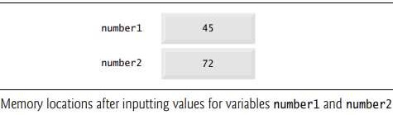

Slide 73
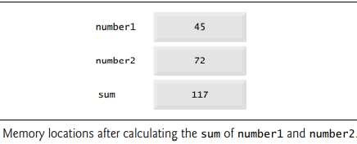

Slide 74
Unlike its predecessor languages C, C++ and Java, JavaScript does not require variables to have a declared type before they can be used in a script
When a variable is declared in JavaScript, but is not given a value, the variable has an undefined value.

Slide 75
Attempting to use the value of such a variable is normally a logic error.
When variables are declared, they’re not assigned values unless you specify them.
Assigning the value null to a variable indicates that it does not contain a value

Slide 76
String properties and Methods
length e.g., var len = str1.length;
var str=“George”;
var len = str1.length; //len→6
charAt(position) e.g., str.charAt(3) //r
indexOf(string) e.g., str.indexOf(‘o’) //2
substring(from, to)e.g., str.substring(2,4) //org
toLowerCase()e.g., str.toLowerCase() //george

Slide 77
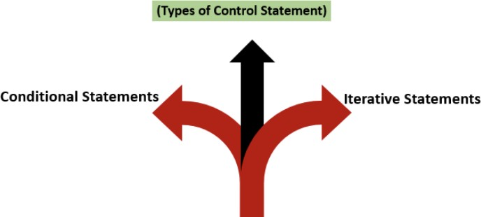
Control statement

Slide 78
Decision Making

Slide 79
Conditional statement
if statement - use this statement if you want to execute some code only if a specified condition is true
if...else statement - use this statement if you want to execute some code if the condition is true and another code if the condition is false

Slide 80
if...else if....else statement - use this statement if you want to select one of many blocks of code to be executed
switch statement - use this statement if you want to select one of many blocks of code to be executed .

Slide 81
if (condition)
{
code to be executed if condition is true
}

Slide 82
JavaScript’s if statement that allows a script to make a decision based on the truth or falsity of a condition.
If the condition is met (i.e., the condition is true), the statement in the body of the if statement is executed.

Slide 83
If the condition is not met (i.e., the condition is false), the statement in the body of the if statement is not executed.
conditions in if statements can be formed by using the equality operators and relational operators

Slide 84
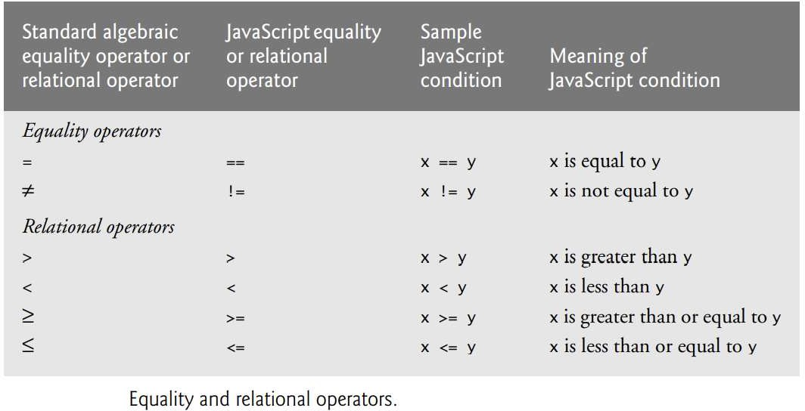

Slide 85
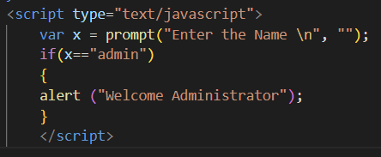
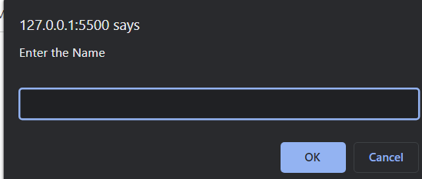
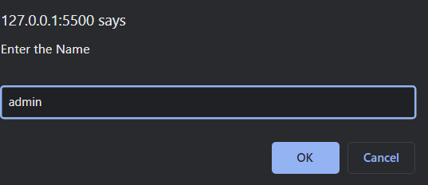
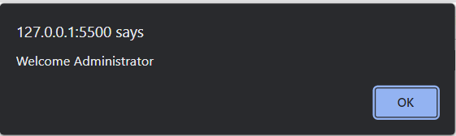

Slide 86
IF ELSE
if (condition)
{
code to be executed if condition is true
}
else
{
code to be executed if condition is not true
}

Slide 87
JavaScript’s if statement that allows a script to make a decision based on the truth or falsity of a condition.
If the condition is met (i.e., the condition is true), the statement in the body of the if statement is executed.
If the condition is not met (i.e., the condition is false), the statement in the body of the else block is executed.

Slide 88
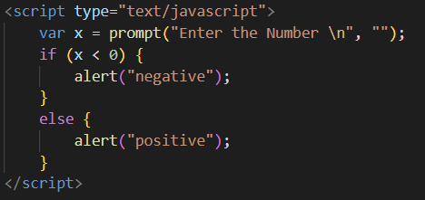

Slide 89
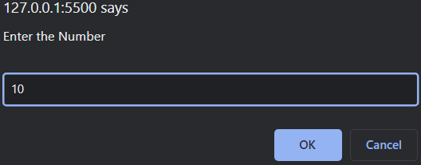


Slide 90
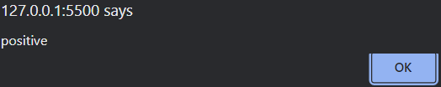
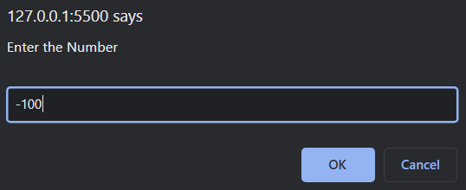
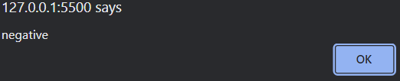

Slide 91
ELSE IF STATEMENT
Use the else if statement to specify a new condition if the first condition is false.
Syntax
if (condition1)
{
block of code to be executed if condition1 is true
}

Slide 92
else if (condition2)
{
block of code to be executed if the condition1 is false and condition2 is true
}
else
{
block of code to be executed if the condition1 is false and condition2 is false
}

Slide 93
Conditional Operator (?:)
JavaScript provides an operator, called the conditional operator (?:), that’s closely related to the if…else statement.
The operator ?: is JavaScript’s only ternary operator—it takes three operands.
The operands together with the ?: form a conditional expression.

Slide 94
The first operand is a Boolean expression, the second is the value for the conditional expression if the expression evaluates to true and the third is the value for the conditional expression if the expression evaluates to false.
document.writeln( studentGrade >= 60 ? "Passed" : "Failed" );
A conditional expression that evaluates to the string "Passed" if the condition studentGrade >= 60 is true and evaluates to the string "Failed" if the condition is false

Slide 95




ELSE IF STATEMENT

Slide 96


Nested if else

Slide 97


Slide 98
Switch statements
Use the switch statement to select one of many blocks of code to be executed.
Syntax switch(expression)
{
case 1: code block
break; …………
case n: code block
break; default: code block
}

Slide 99
The switch expression is evaluated once.
The value of the expression is compared with the values of each case.
If there is a match, the associated block of code is executed

Slide 100


Slide 101



Slide 102


Slide 103
Loop Statements
Different Kinds of Loops
JavaScript supports different kinds of loops:
for - loops through a block of code a number of times
For a loop, when you execute a loop for a fixed number of times, the loop does three specified tasks (Statement 1, Statement 2, Statement 3)

Slide 104
for/in - loops through the properties of an object
while - loops through a block of code while a specified condition is true
do/while - also loops through a block of code while a specified condition is true
It will execute at least once even if the condition is to be not satisfied. If the condition is true, it will continue executing and once the condition becomes false, it stops the code execution.

Slide 105
for (statement 1; statement 2; statement 3)
{
code block to be executed
}
Statement 1 is executed before the loop (the code block) starts.

Slide 106
Statement 2 defines the condition for running the loop (the code block).
Statement 3 is executed each time after the loop (the code block) has been executed.
Example
for (i = 0; i < 5; i++)
{
text += "The number is " + i + ""; alert(text);
}

Slide 107


Slide 108



Slide 109
For..in
The JavaScript for/in statement loops through the properties of an object:
Example
<script type=“text/javascript”>
var x;
var cars =["Maruthi","Toyoto", "BMW"];
for (x in cars)
{
alert(x+ "="+ cars[x]);
}
</script>

Slide 110
While loop statements
The while loop loops through a block of code as long as a specified condition is true. while (condition)
{
code block to be executed }
<script type="text/javascript"> var i=0;
while (i < 10)
{
alert("i="+i); i++;
}
</script>

Slide 111



Slide 112

Do ..While loop statements

Slide 113


Slide 114
The do/while loop is a variant of the while loop.
This loop will execute the code block once, before checking if the condition is true, then it will repeat the loop as long as the condition is true.
Syntax do
{
code block to be executed
}
while (condition);

Slide 115
Break statements
The break statement "jumps out" of a loop.
It was used to "jump out" of a switch() statement
break statement also be used to jump out of a loop.
The break statement breaks the loop and continues executing the code after the loop (if any):
Example

Slide 116


Slide 117
continue statement
The continue statement "jumps over" one iteration in the loop.
The continue statement breaks one iteration (in the loop), if a specified condition occurs, and continues with the next iteration in the loop.
This example skips the value of 3

Slide 118


Slide 119
A palindrome is a number or a text phrase that reads the same backward and forward.
For example, each of the following five-digit integers is a palindrome: 12321, 55555, 45554 and 11611.
Write a script that reads in a five-digit integer and determines whether it’s a palindrome.
If the number is not five digits long, display an alert dialog indicating the problem to the user.
Allow the user to enter a new value after dismissing the alert dialog.

Slide 120
Functions
function function_name([formal_parameters])
{ -- body – }
Return value is the parameter of return ,If there is no return, or if the end of the function is reached, undefined is returned .
If return has no parameter, undefined is returned

Slide 121
Function call -Functions are invoked by writing the name of the function, followed by a left parenthesis, followed by a comma-separated list of zero or more arguments, followed by a right parenthesis
If fun is the name of a function,
var a=fun();
or
fun(); /* A call to fun */

Slide 122


Slide 123
The parameter values that appear in a call to a function are called actual parameters.
The parameter names that appear in the header of a function definition, which correspond to the actual parameters in calls to the function, are called formal parameters.
JavaScript uses the pass-by-value parameter-passing method.
When a function is called, the values of the actual parameters specified in the call are copied into their corresponding formal parameters, which behave exactly like local variables.

Slide 124



Slide 125


Slide 126


Slide 127


Slide 128


Slide 129
Scripts can also be placed in external files:
External file:// myScript.js function test()
{
document.getElementById("demo").innerHTML = “welcome to Javascript.";
}

Slide 130
External scripts are practical when the same code is used in many different web pages.
JavaScript files have the file extension .js.
To use an external script, put the name of the script file in the src (source) attribute of a <script> tag and embed in the html doc:
<script src="myScript.js"></script>

Slide 131

Example-Maximum of three numbers using user defined function

Slide 132


Slide 133



Slide 134
Recursion
A recursive function is a function that calls itself, either directly, or indirectly through another function.
The recursion step executes while the original call to the function is still open (i.e., it has not finished executing).

Slide 135
The recursion step can result in many more recursive calls as the function divides each new subproblem into two conceptual pieces.
For the recursion eventually to terminate, each time the function calls itself with a simpler version of the original problem, the sequence of smaller and smaller problems must converge on the base case.

Slide 136


Slide 137




Slide 138
Recursion Vs Iteration
Both iteration and recursion are based on a control statement:
Iteration uses a repetition statement (e.g., for, while or do…while);
recursion uses a selection statement (e.g., if, if…else or switch).
Both iteration and recursion involve repetition:
Iteration explicitly uses a repetition statement;
recursion achieves repetition through repeated function calls.

Slide 139
Iteration and recursion each involve a termination test:
Iteration terminates when the loop-continuation condition fails;
recursion terminates when a base case is recognized.
Both iteration and recursion can occur infinitely:
An infinite loop occurs with iteration if the loop-continuation test never becomes false;
infinite recursion occurs if the recursion step does not reduce the problem each time via a sequence that converges on the base case or if the base case is incorrect

Slide 140
ARRAYS
Arrays are data structures consisting of related data items.
JavaScript arrays are “dynamic” entities in that they can change size after they’recreated.
An array is a group of memory locations that all have the same name and normally are of the same type (although this attribute is not required in JavaScript).
To refer to a particular location or element in the array, we specify the name of the array and the position number of the particular element in the array
The first element in every array is the zeroth element.

Slide 141
Thus, the first element of array c is referred to as c[0], the second element as c[1].
The position number in square brackets is called an index and must be an integer or an integer expression.

Slide 142
JavaScript arrays are used to store multiple values in a single variable.
Example
var cars = [“Maruthi",“Toyoto","BMW"];
An array can hold many values under a single name,
Access the values of array by referring to an index number.
Creating an Array Using an array literal we can create a JavaScript Array.
Syntax: var array_name = [item1, item2, ...];

Slide 143
The following example also creates an Array, and assigns values to it:
Example
var s = new Array(“AA", ”BB",“CC”);
var list = new Array(2, 4, 6, 8);

Slide 144
var n = [ 10, 20, 30, 40, 50 ];
Uses a comma-separated initializer list enclosed in square brackets ([ and ]) to create a five element array with indices of 0, 1, 2, 3 and 4.
The array size is determined by the number of values in the initializer list.
var n = new Array( 10, 20, 30, 40, 50 );
Also creates a five-element array with indices of 0, 1, 2, 3 and 4.

Slide 145
In this case, the initial values of the array elements are specified as arguments in the parentheses following new Array.
The size of the array is determined by the number of values in parentheses
var n = [ 10, 20, , 40, 50 ];
creates a five-element array in which the third element (n[2]) has the value undefined

Slide 146
An array element can be accessed by referring to the index number.
To access the value of the first element in s: var name = s[0];
<script>
var s = ["AA", "BB", "CC"];
alert(s[0]+" "+s[1]+" "+s[2]);
</script>

Slide 147
The length property of an array returns the length of an array (the number of array elements). Ex)
var s = new Array(“AA", ”BB",“CC”);
alert(s.length);
//return 3

Slide 148


Slide 149
ARRAY properties and methods
Adding Array Elements
To add a new element to an array is using the push method:
s.push(“XX");

Slide 150


Slide 151
Adding Array Elements
New element can also be added to an array using the length property:
var s = ["BB", "OO", "AA", "MM"];
s[s.length] = "LL"; //add as last element

Slide 152
Adding elements with high indexes can create undefined "holes" in an array:
var s = ["BB", "OO", "AA", "MM"];
s[6] = "PP“

Slide 153
Popping Array Elements
The pop() method removes the last element from an array:
Example
var s = ["AA", "BB", "CC"];
s.pop();
// Removes the last element (“CC") from array s

Slide 154
The pop() method returns the value that was "popped out":
Example
var s = ["BB","OO","AA",“MM"];
var x = s.pop();
// the value of x is "MM"

Slide 155
Shifting is equivalent to popping, working on the first element instead of the last.
The shift() method removes the first array element and "shifts" all other elements to a lower index.
Example
var s = ["BB", "OO", "AA", “MM"];
s.shift();
// Removes the first element "BB" from ‘ s’

Slide 156
The shift() method returns the string that was "shifted out":
Example
var s = ["BB", "OO", "AA", “MM"];
alert(s.shift()); //dislays "BB"

Slide 157
The unshift() method adds a new element to an array (at the beginning), and "unshifts" older elements:
Example
var s = ["BB", "OO", "AA", “MM"];
s.unshift(“PP"); // Adds a new element “PP" to s
The unshift() method returns the new array length.

Slide 158
Example
var s = ["BB", "OO", "AA", “MM"];
alert(s.unshift(“PP");
// Returns 5

Slide 159


Slide 160
Deleting Elements
Since JavaScript arrays are objects, elements can be deleted by using the JavaScript operator delete:
Example
var s = ["BB", "OO", "AA",“MM"];
delete s[0];
// Changes the first element in s to undefined
Using delete may leave undefined holes in the array.
Use pop() or shift() instead.

Slide 161
Splicing an Array
The splice() method can be used to add new items to an array:
Example
var fruits = ["Banana","Orange", "Apple", "Mango"];
fruits.splice(2, 0, "Lemon", "Kiwi");

Slide 162
The first parameter (2) defines the position where new elements should be added (spliced in).
The second parameter (0) defines how many elements should be removed.
The rest of the parameters ("Lemon" , "Kiwi") define the new elements to be added.

Slide 163


Slide 164
Merging an Array
concat() method creates a new array by merging (concatenating) existing arrays:
Example (Merging Two Arrays)
var girls = [“ammu",“annu"];
var boys = ["Emil",“richu","Linu"];
var mystds = girls.concat(boys); //Concatenates (joins) girls and boys

Slide 165
The concat() method does not change the existing arrays.
It always returns a new array.
The concat() method can take any number of array arguments:

Slide 166
Example (Merging Three Arrays)
var arr1 = ["cilie","Lona"];
var arr2 = ["Emil","Tobias","Linus"];
var arr3 = ["Robin","Morgan"];
var myChildren = arr1.concat(arr2, arr3); // Concatenates arr1 with arr2 and arr3

Slide 167
The concat() method can also take values as arguments:
Example (Merging an Array with Values)
var arr1 = ["Cecilie", "Lone"];
var myChildren = arr1.concat(["Emil", "asi", "Linu"]);

Slide 168
slice() method slices out a piece of an array into a new array.
slices out a part of an array starting from array element 1 ("Orange"):
var fruits = ["Banana", "Orange", "Lemon", "Apple", "Mango"];
var citrus = fruits.slice(1);
slice() method creates a new array.
It does not remove any elements from the source array.

Slide 169
This example slices out a part of an array starting from array element 3 ("Apple"):
var fruits = ["Banana","Orange","Lemon","Apple","Mango"];
var citrus = fruits.slice(3);
The slice() method can take two arguments like slice(1, 3).

Slide 170
The method then selects elements from the start argument, and up to (but not including) the end argument.
var fruits = ["Banana","Orange","Lemon","Apple","Mango"];
var citrus = fruits.slice(1,3);
The sort() method sorts an array alphabetically:
var fruits = ["Banana","Orange","Apple","Mango"];
fruits.sort(); // Sorts the elements of fruits

Slide 171
Numeric Sort
By default, the sort() function sorts values as strings.
This works well for strings .
However, if numbers are sorted as strings, "25" is bigger than "100", because "2" is bigger than "1".

Slide 172
Because of this, the sort() method will produce incorrect result when sorting numbers
Use compare function for numeric sorting.
A function that defines an alternative sort order.
The function should return a negative, zero, or positive value, depending on the arguments, like:
function(a, b)
{
return a-b;
}

Slide 173
When the sort() method compares two values,itsends the values to the compare function,and sorts the values according to the returned (negative, zero, positive) value.
Example:
When comparing 40 and 100, the sort() method calls the compare function(40,100).
The function calculates 40-100, and returns -60 (a negative value).
The sort function will sort 40 as a value lower than 100.

Slide 174


Slide 175
The reverse() method reverses the elements in an array.
use it to sort an array in descending order:
var fruits = ["Banana", "Orange", "Apple","Mango"];
fruits.sort();
// Sorts the elements of fruits
fruits.reverse();
// Reverses the order of the elements

Slide 176
Associate Arrays
Arrays with named indexes are called associative arrays (or hashes).
JavaScript does not support arrays with named indexes.
In JavaScript, arrays always use numbered indexes.

Slide 177
Example
var person = [];
person[0] = "John";
person[1] = "Doe";
person[2] = 46;
var x = person.length; // person.length will return 3
var y = person[0]; // person[0] will return "John"

Slide 178
If you use named indexes, JavaScript will redefine the array to a standard object.
After that, some array methods and properties will produce incorrect results.

Slide 179
Example:
var person = [];
person["firstName"] = "John";
person["lastName"] = "Doe";
person["age"] = 46;
var x = person.length; // person.length will return 0
var y = person[0]; // person[0] will return undefined

Slide 180
Multi Dimensional Arrays
Multidimensional arrays with two indices are often used to represent tables of values consisting of information arranged in rows and columns
Arrays that require two indices to identify a particular element are called two- dimensional arrays.
Multidimensional arrays can have more than two dimensions.
JavaScript does not support multidimensional arrays directly, but it does allow you to specify arrays whose elements are also arrays.
An array with m rows and n columns is called an m-by-n array.

Slide 181
Every element in array a is identified by an element name of the form a[row][column].
a is the name of the array, and row and column are the indices that uniquely identify the row and column, respectively, of each element in a.
The element names in row 0 all have a first index of 0;
the element names in column 3 all have a second index of 3.

Slide 182


Slide 183
Arrays of One dimensional Arrays
Multidimensional arrays can be initialized in declarations like a one-dimensional array.
Array b with two rows and two columns could be declared and initialized with the statement .
Two-dimensional array with three rows and four columns.

Slide 184
The values are grouped by row in square brackets.
The array [1, 2] initializes element b[0], and
the array [3, 4] initializes element b[1].
So 1 and 2 initialize b[0][0] and b[0][1], respectively.

Slide 185
Similarly, 3 and 4 initialize b[1][0] and b[1][1], respectively.
interpreter determines the number of rows by counting the number of subinitializer lists— arrays nested within the outermost array.
The interpreter determines the number of columns in each row by counting the number of values in the subarray.

Slide 186
Two-Dimensional Arrays with Rows of Different Lengths and new
The rows of a two-dimensional array can vary in length.
The declaration var b = [ [ 1, 2 ], [ 3, 4, 5 ] ];
creates array b with row 0 containing two elements (1 and 2) and row 1 containing three elements (3, 4 and 5).
Creating Two-Dimensional Arrays with new

Slide 187
A multidimensional array in which each row has a different number of columns can be allocated dynamically, as follows:
var b;
b = new Array( 2 ); // allocate two rows
b[ 0 ] = new Array( 5 ); // allocate columns for row 0
b[ 1 ] = new Array( 3 ); // allocate columns for row 1
The preceding code creates a two-dimensional array with two rows. Row 0 has five columns, and row 1 has three columns.

Slide 188



Slide 189
OBJECTS
In JavaScript, object is the king.
Almost "everything" is an object.
Booleans can be objects (if defined with the new keyword)
Numbers can be objects (if defined with the new keyword)
Strings can be objects (if defined with the new keyword)

Slide 190
Dates are always objects
Maths are always objects
Regular expressions are always objects
Arrays are always objects
Functions are always objects
All JavaScript values, except primitives, are objects

Slide 191
With JavaScript, you can define and create your own objects.
There are different ways to create new objects:
Define and create a single object, using an object literal.
2)Define and create a single object, with the keyword new.

Slide 192
JavaScript objects are written with curly braces.
Object properties are written as name:value pairs, separated by commas.
The following example creates a new JavaScript object with four properties:
var person = {firstName:“xyz”, lastName:“pqr", age:50, eyeColor:"blue"};

Slide 193
The object (person) in the example above has 4 properties:
firstName, lastName, age, and eyeColor.
A JavaScript object is a collection of named values
The named values, in JavaScript objects, are called properties.

Slide 194
The following example also creates a new JavaScript object with four properties:
Properties are the values associated with a JavaScript object.
A JavaScript object is a collection of unordered properties.
Properties can usually be changed, added, and deleted, but some are read only

Slide 195
Example
var person = new Object();
person.firstName = “xyz";
person.lastName = “pqr";
person.age = 50;
person.eyeColor = "blue";

Slide 196
Add new OBJECT properties & Accessing OBJECT properties
You can add new properties to an existing object by simply giving it a value.
Assume that the person object already exists - you can then give it new properties:
Example person.city = ”kochi";
syntax for accessing the property of an object is:
objectName.property person.age
or
objectName["property"] person["age"]
or
objectName[expression] ------- x = "age"; person[x]

Slide 197
Accessing OBJECT properties
person.firstname + " is " + person.age + " years old."; or
person["firstname"] + " is " + person["age"] + " years old.";
The JavaScript for...in statement loops through the properties of an object.
Syntax
for (variable in object)
{
code to be executed
}
The block of code inside of the for...in loop will be executed once for each property.

Slide 198

Looping through the OBJECT

Slide 199



Slide 200
Delete the properties of OBJECT
The delete keyword deletes a property from an object:
Example
var person = {fname:“xyz", lname:“pqr", age:50, city:“kochi"};
delete person.age;
or
delete person["age"];
The delete keyword deletes both the value of the property and the property itself.

Slide 201
After deletion, the property cannot be used before it is added back again.
The delete operator is designed to be used on object properties.
It has no effect on variables or functions

Slide 202
STRINGS, NUMBERS, AND BOOLEANS AS OBJECTS
When a JavaScript variable is declared with the keyword "new", the variable is created as an object:
var x = new String();
// Declares x as a String object
var y = new Number();
// Declares y as a Number object
var z = new Boolean();
// Declares z as a Boolean object
Avoid String, Number, and Boolean objects.

Slide 203

Math Object methods

Slide 204


Slide 205

String Object methods

Slide 206
Character processing methods
charAt—returns the character at a specific position
charCodeAt— returns the Unicode value of the character at a specific position
fromCharCode—returns a string created from a series of Unicode values
toLowerCase—returns the lowercase version of a string
toUpperCase—returns the uppercase version of a string

Slide 207


Slide 208

Date Object Methods

Slide 209


Slide 210
Boolean and Number Objects
When a JavaScript program requires a boolean value, JavaScript automatically creates a Boolean object to store the value.
var b = new Boolean( booleanValue );
The booleanValue specifies whether the Boolean object should contain true or false.
If booleanValue is false, 0, null, Number.NaN or an empty string (""), or if no argument is supplied, the new Boolean object contains false.

Slide 211


Slide 212
Boolean and Number Objects
JavaScript automatically creates Number objects to store numeric values in a script.
You can create a Number object with the statement
var n = new Number( numericValue );
The constructor argument numeric Value is the number to store in the object.
We can explicitly create Number objects, normally the JavaScript interpreter creates them as needed

Slide 213
Document Objects
The document object, which we’ve used extensively, is provided by the browser and allows JavaScript code to manipulate the current document in the browser.
The document object has several properties and methods, such as method document.getElementByID.

Slide 214


Slide 215
DOCUMENT OBJECT MODEL
The DOM gives you scripting access to all the elements on a web page.
Inside the browser, the whole web page paragraphs,forms, tables,etc. is represented in an object hierarchy.
Using DOM, we can dynamically create, modify and remove elements in the page.
JavaScript can change all the HTML elements in the page
JavaScript can change all the HTML attributes in the page

Slide 216
JavaScript can change all the CSS styles in the page
JavaScript can remove existing HTML elements and attributes
JavaScript can add new HTML elements and attributes
JavaScript can react to all existing HTML events in the page
JavaScript can create new HTML events in the page

Slide 217
DOM nodes and Trees
The document’s getElementById method is the simplest way to access a specific element in a page.
The method returns objects called DOM nodes.
Every piece of an HTML5 page (elements, attributes, text, etc.) is modeled in the web browser by a DOM node.
All the nodes in a document make up the page’s DOM tree, which describes the relationships among elements.

Slide 218
Nodes are related to each other through child-parent relationships.
An HTML5 element inside another element is said to be its child the containing element is known as the parent.
A node can have multiple children but only one parent.
Nodes with the same parent node are referred to as siblings.

Slide 219
The head and body nodes are siblings, since they’re both children of the html node.
The head contains the meta and title nodes
The body node contains nodes representing each of the elements in the document’s body element.
The li nodes are children of the ul node, since they’re nested inside it.

Slide 220


Slide 221


Slide 222
DOM is a model for describing HTML documents
A common set of properties/methods to access everything in a web document
When a web page is loaded, the browser creates a Document Object Model of the page.
The HTML DOM model is constructed as a tree of Objects:

Slide 223
Objects are in a hierarchy
The window is the parent for a given web page
Document is the child with the objects that are most commonly manipulated
The HTML DOM is a standard for how to get, change, add, or delete HTML elements.
HTML DOM methods are actions you can perform (on HTML Elements).
HTML DOM properties are values (of HTML Elements) that you can set or change.

Slide 224


Slide 225

FINDING & CHANGING HTML ELEMENTS

Slide 226

ADDING AND DELETING HTML ELEMENTS

Slide 227
CHANGING THE VALUE OF AN ATTRIBUTE
To change the value of an HTML attribute, use this syntax: document.getElementById(id).attribute = new value
<!DOCTYPE html>
<html><body><img id=“clg“ src=“sjc.jpg">
<script>
document.getElementById(“clg").src =“ceklogo.jpg";
</script>
</body>
</html>

Slide 228
CHANGING THE style
To change the style of an HTML element, use this syntax: document.getElementById(id).style.property = new style
<html>
<body>
<p id="p1">Hello World!</p>
<script>
document.getElementById("p1").style.color = "blue";
</script>
<p>The paragraph above was changed by a script.</p>
</body>
</html>

Slide 229
DOM EVENTS
onsubmit - call when submit button is clicked
onclick - call when this button is clicked
onreset - call when the reset button is clicked
onload - call after page loads
onmouseover - call when mouse pointer enters image area
onmouseout - call when mouse pointer leaves image area
onfocus - call when control receives focus
onblur - call when a control loses focus
onchange - call when a control loses focus and the value of its contents has changed many more

Slide 230



Event handling using DOM –onclick and onMouseover

Slide 231


Slide 232

Form Handling –onclick event

Slide 233


Slide 234


Form Handling –onclick event

Slide 235
Node in DOM
Nodes can be between HTML Tags.
Nodes available in DOM:
node.childNodes
node.firstChild
node.lastChild
node.parentNode
node.nextSibling
node.previousSibling

Slide 236
Adding and Removing Nodes (HTML Elements) in DOM
To add a new element to the HTML DOM, you must create the element (element node) first, and then append it to an existing element

Slide 237


Slide 238
This code creates a new <p> element:
const para = document.createElement("p");
To add text to the <p> element, you must create a text node first. This code creates a text node
: const node = document.createTextNode("This is a new paragraph.");
Then you must append the text node to the <p> element: para.appendChild(node);

Slide 239
Finally you must append the new element to an existing element.
This code finds an existing element:
const element = document.getElementById("div1");
This code appends the new element to the existing element:
element.appendChild(para);

Slide 240

Insert before in Node

Slide 241

Remove()

Slide 242
DOM Collection
The Document Object Model contains several collections, which are groups of related objects on a page.
DOM collections are accessed as properties of DOM objects such as the document object or a DOM node.
The document object has properties containing the
images collection
links collection
forms collection
anchors collection
These collections contain all the elements of the corresponding type on the page.

